Slide 1



Checking Database
NHS Automation Team

Slide 2
Database CheckPoint
Checking Database
We can create a check on a database in order to check the contents of the entire result set, or a part of it. QuickTest captures the current data from the database and saves this information as expected data.
This checkpoint is displayed in the Expert View as a DbTable.Check
checkPoint statement and as a step in the Keyword View, as follows:
When we run the test or component, the database checkpoint compares the current data in the database to the expected data defined in the Database Checkpoint Properties dialog box.

Slide 3
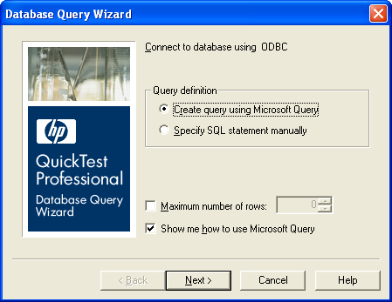
Creating a Database Checkpoint
Checking Databases
We can define the query for the checkpoint using Microsoft Query
or by manually entering a database connection and SQL statement.
To create a database checkpoint:
  Choose Insert > Checkpoint > Database Checkpoint. The Database Query Wizard opens.

Slide 4
Creating a Database Checkpoint (Contd…)
Checking Databases
2. Select the database and click Next.
We can choose from the following options:
Create query using Microsoft Query—Opens Microsoft Query, enabling you to create a new query.
Specify SQL statement manually—Opens the Specify SQL statement screen in the wizard, which enables you to specify the connection string and an SQL statement.
Maximum number of rows—Select this check box if you would like to limit the number of rows and enter the maximum number of database rows to check.
Show me how to use Microsoft Query—Displays an instruction screen when you click Next before opening Microsoft Query.

Slide 5
Creating a Database Checkpoint (Contd…)
Checking Databases
3. If we chose Create query using Microsoft Query in the previous step, Microsoft Query opens. Choose a data source and define a query.
To choose a data source and define a query in Microsoft Query:
A. When Microsoft Query opens during the insert database
checkpoint process, choose a new or an existing data
source.
B. Define a query.
C. When you are done, in the Finish screen of the Query
Wizard, select Exit and return to QuickTest Professional
and click Finish to exit Microsoft Query.

Slide 6
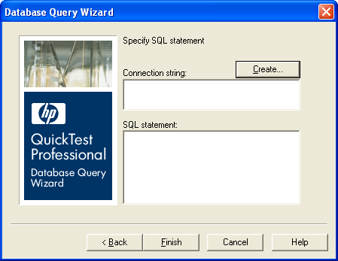
Creating a Database Checkpoint (Contd…)
Checking Databases
If we chose Specify SQL statement in the previous step, the
Specify SQL statement screen opens.
To specify SQL statements:
1.Choose Specify SQL statement in the Database Query Wizard screen. The below screen opens:
2. Specify the connection string and the SQL statement, and click Finish.

Slide 7
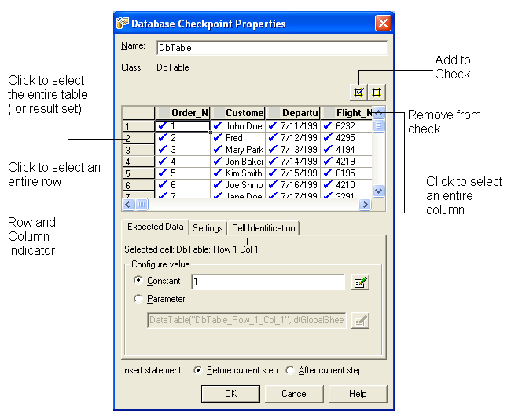
Creating a Database Checkpoint (Contd…)
Checking Databases
3. The Checkpoint Properties dialog box opens. Select the checks to perform on the result set
4. Click OK to close the dialog box. A checkpoint statement is added for the selected object in the Keyword View and Expert View.

Slide 8
Modifying a Database Checkpoint
Checking Databases
To modify the expected data in a database checkpoint:
In the Keyword View or Expert View, right-click the database checkpoint that you want to modify.
Select Checkpoint Properties. The Checkpoint Properties dialog box opens.

Slide 9
Modifying a Database Checkpoint
Checking Databases
To modify a Database checkpoint:
  Modify the SQL query definition.
  Modify the expected data, verification type, or method.
To modify the SQL query definition:
  In the Keyword View, right-click the database object that you want to modify.
  Select Object Properties.
  Modify the SQL and connection string properties as necessary and click OK.

Slide 10
Summary of the Topics Covered
Checking Databases
Database CheckPoint
Creating a Database Checkpoint
Modifying a Database Checkpoint
Questions?

Slide 11

Thank You

